Slide 1
Introduction to Anaconda and Jupyter notebook
ISOM 3360
Spring 2019-2020
Lab 1

Slide 2
More about Lab sessions for this course
Lab
Conduct online via Zoom
Use python as the tool to complete data mining tasks
Help you to further understand concepts taught in lectures
Help you to work on your project
5% of your final grade
What should you to get the 5%
We do not record attendance
You need to complete the lab quiz before each Friday (the weeks we have lab sessions)11:59pm, please refer to lab schedule and the exact due dates on Canvas.
The Lab Quizzes
In total 10 lab quizzes
Each quiz consists with around 5 to 7 questions, in the form of MC, T/F, short answers
3 attempts for each quiz, taking the highest score
Any questions about the lab please email
imsophie@ust.hk

Slide 3
About the Lab
The focus of the lab is more on the application side
Algorithm development VS. Model tuning
Tools for this course/lab
Weka
RapidMiner
Azure
Python (Anaconda / Jupyter notebook)

Slide 4
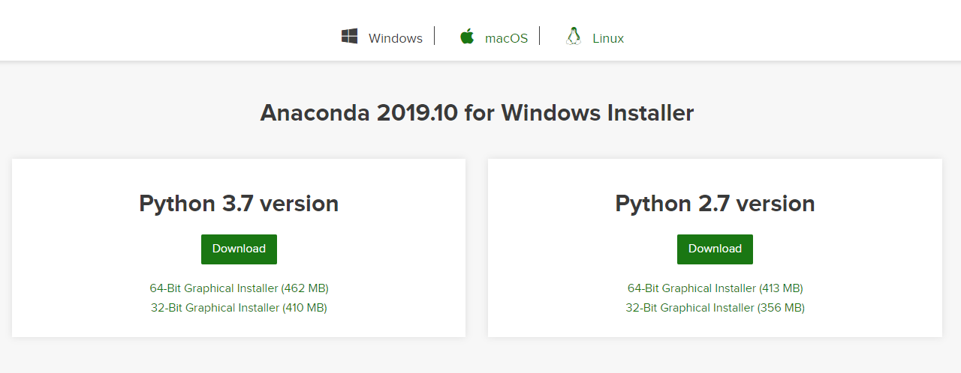
Install Anaconda
Download the latest version of Anaconda (Python 3.7 version) for your OS (Windows / MacOS / Linux) (https://www.anaconda.com/download/)

Slide 5
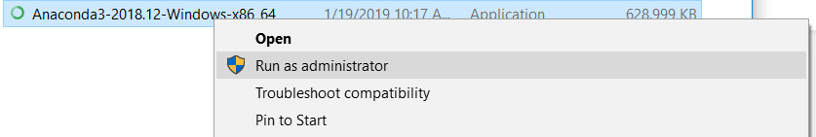
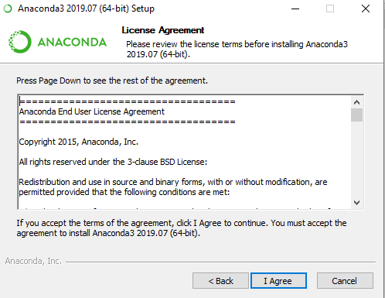
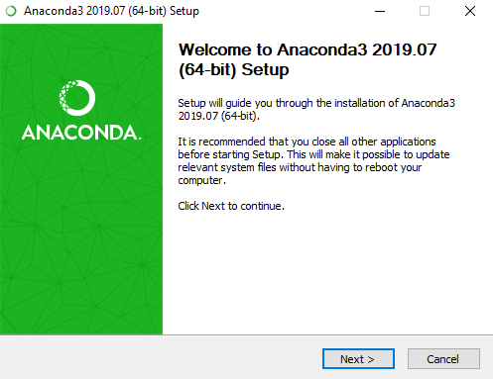
Install Anaconda
Right click, Run as administrator

Slide 6
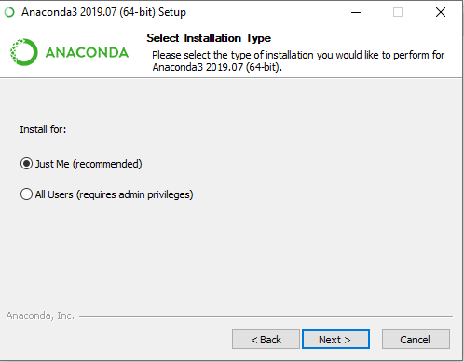
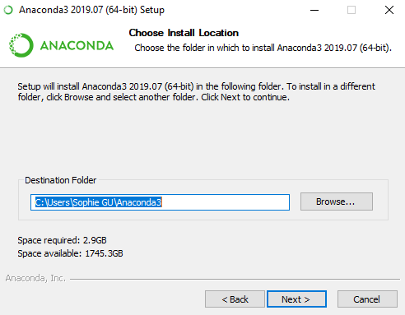
Install Anaconda
Install for: Just Me (recommended)

Slide 7
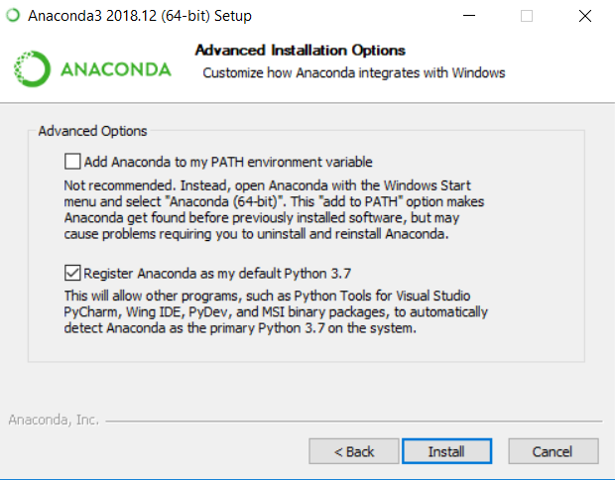
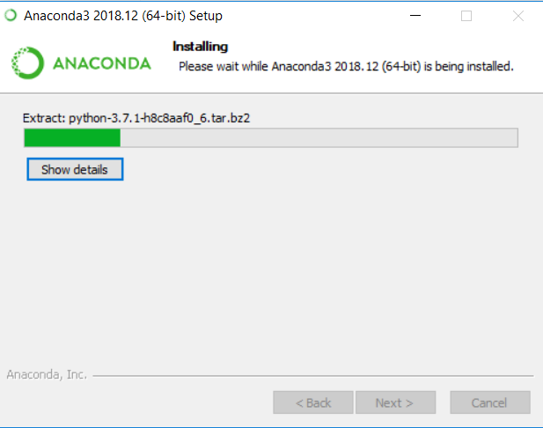
Install Anaconda

Slide 8
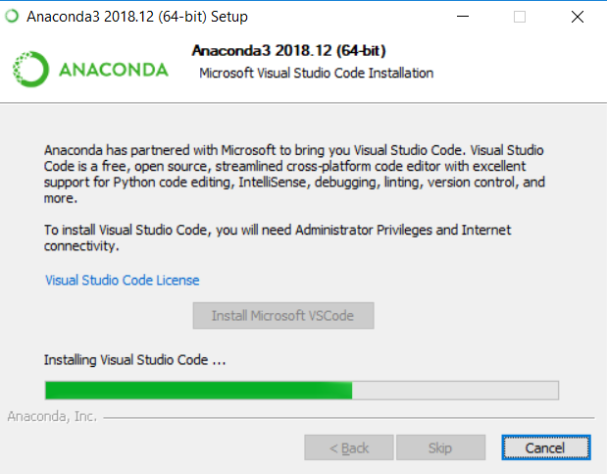
Install Anaconda
Also “Install Microsoft VSCode”
Wait until installation finish

Slide 9
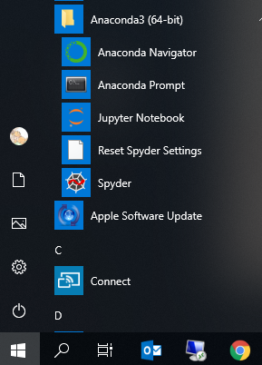
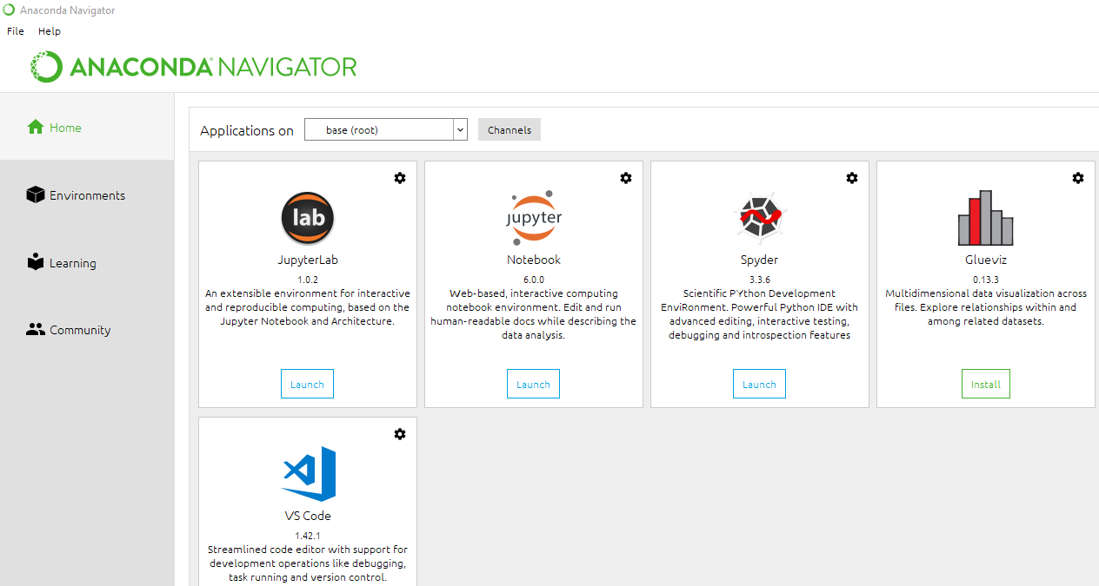
Launch Jupyter notebook
You will find Anaconda Navigator in start menu, click “Launch” to launch jupyter notebook

Slide 10
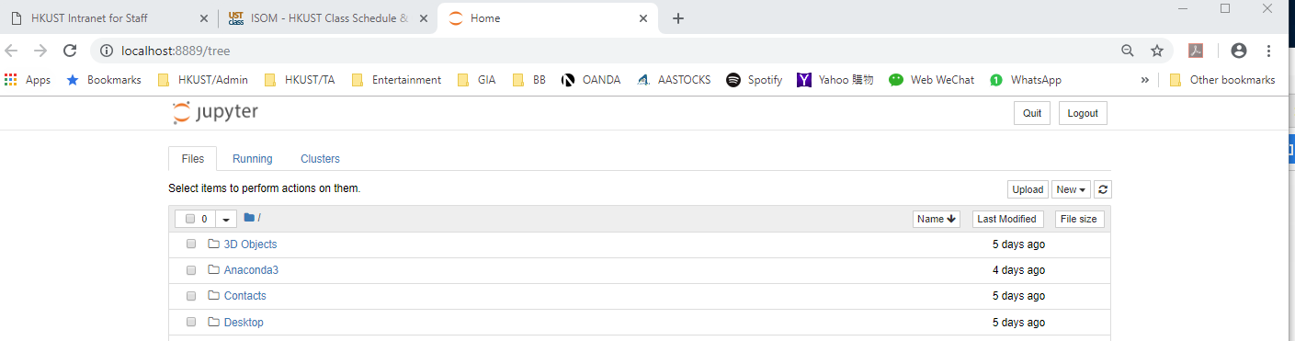
Launch Jupyter notebook
You will be bringing back to a web page where we can create python file and run it in Jupyter notebook

Slide 11
Titanic Example
Import Libraries
Load datasets
View datasets
Get basic information of datasets
Information about variables
Change data type
Check missing value
# import libraries
import numpy as np
import pandas as pd
train.describe() train['Cabin'].describe()
#load datasets
train = pd.read_csv('train.csv')
train['Pclass'] = train['Pclass'].astype(str)
#view first 5 rows/instances of the dataset
train.head()
train.isnull().sum() train[train['Embarked'].isnull()]
#get basic information of datasets
train.info()

